Slide 1
CS7/8745 : Machine Learning Instructor: Salim Sazzed Department of Computer Science University of Memphis

Slide 2
Linear and Logistic Regression

Slide 3
Regression Analysis
A regression is a statistical technique that relates a dependent variable to one or more independent (explanatory) variables.
Explain the impact of changes in an independent variable on the dependent variable

Slide 4
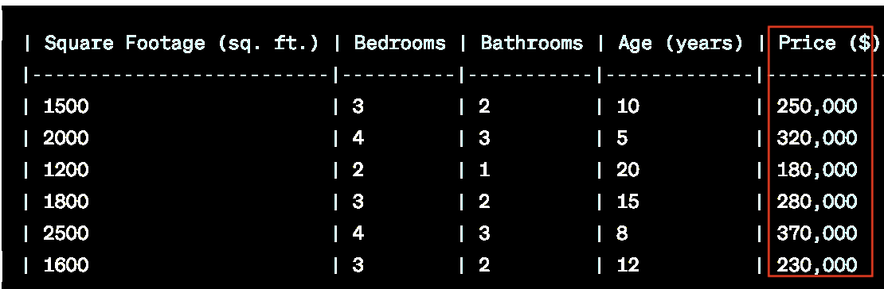
Regression analysis is used to:
Predict the value of a dependent variable based on the value of at least one independent variable
Dependent variable: the variable we wish to predict or explain
Independent variable: the variable used to predict or explain the dependent variable (predictor).

Slide 5
Simple Linear Regression Model
House Price (Y) Vs house Size (X)
Only one independent variable, X
Relationship between X and Y is described by a linear function
Changes in Y are assumed to be related to changes in X

Slide 6
Simple Linear Regression
The simple linear regression equation provides an estimate of the population regression line
Estimated (or predicted) Y value for observation i
b₀ is the estimated mean value of Y when the value of X is zero
b₁ is the estimated change in the mean value of Y as a result of a one-unit increase in X
Estimate of the regression intercept
Estimate of the regression slope
Value of X for observation i

Slide 7

Simple Linear Regression Example
A real estate agent wishes to examine the relationship between the selling price of a home and its size (measured in square feet)
A random sample of 10 houses is selected
Dependent variable (Y) = house price in $1000s
Independent variable (X) = square feet

Slide 8
Simple Linear Regression Example: Data
House Price in $1000s (Y) | Square Feet (X)
245 | 1400
312 | 1600
279 | 1700
308 | 1875
199 | 1100
219 | 1550
405 | 2350
324 | 2450
319 | 1425
255 | 1700

Slide 9
Simple Linear Regression Example: Scatter Plot
House price model: Scatter Plot
https://www.ncl.ac.uk/webtemplate/ask-assets/external/maths-resources/statistics/regression-and-correlation/simple-linear-regression.html
https://www.analyticsvidhya.com/blog/2021/10/everything-you-need-to-know-about-linear-regression/

Slide 10

Creating a simple linear regression model involves fitting a linear relationship between two variables, typically denoted as "x" (the independent variable) and "y" (the dependent variable).
The goal is to find a line of best fit that minimizes the (root) sum of the squared differences between the observed data points and the predicted values on the line.
The Root Mean Squared Error is the square root of the variance of the residuals. It specifies the absolute fit of the model to the data i.e. how close the observed

Slide 11
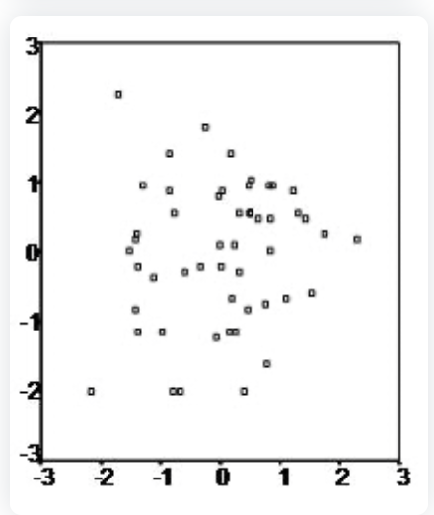
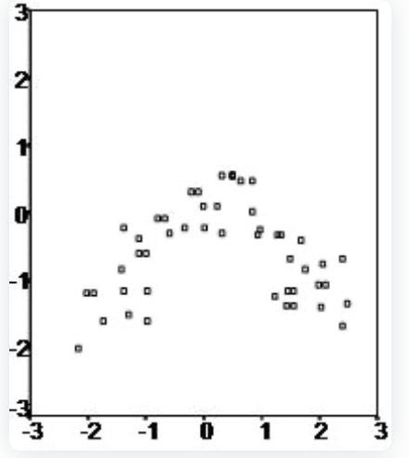
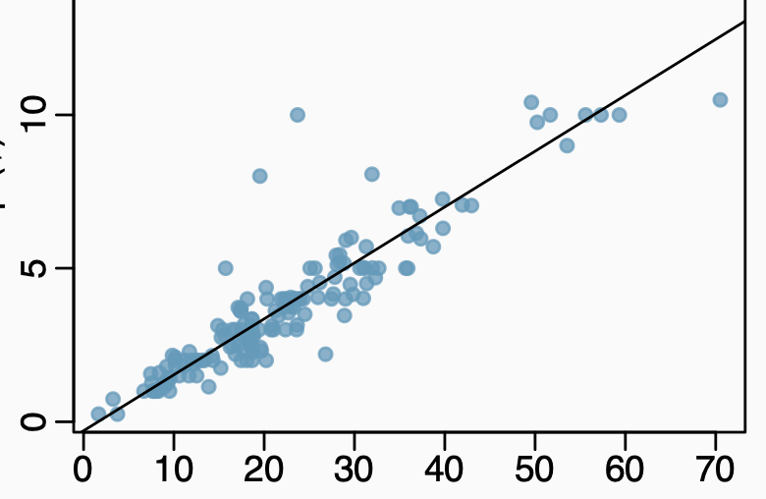
Some conditions:
Linearity
Linear
Non-Linear
2. Constant variability: The variability in a data set should be consistent across all data points, with no extreme outliers (e.g., Normal Distribution, Binomial Distribution).

Slide 12
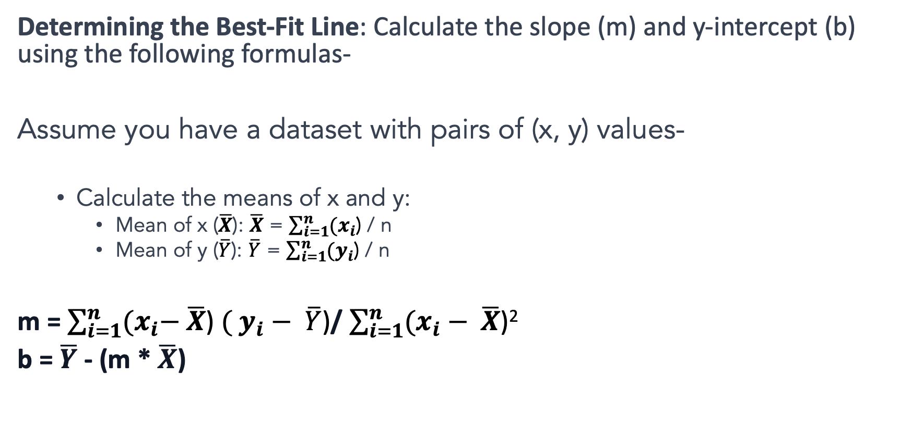
Determining the Best-Fit Line: Calculate the slope (m) and y-intercept (b) using the following formulas-
Assume you have a dataset with pairs of (x, y) values-
Calculate the means of x and y:
Mean of x ($\overline{X}$): $\overline{X}$ = $\sum_{i=1}^{n}{{(x}_{i}\text{)}}$ / n
Mean of y ($\overline{Y}$): $\overline{Y}$ = $\sum_{i=1}^{n}{{(y}_{i}\text{)}}$ / n
m = $\sum_{i=1}^{n}{{(x}_{i}− \overline{X}\text{)} ( y_{i}− \overline{Y}\text{)}}$/ $\sum_{i=1}^{n}{(x_{i}− \overline{X}\text{)}\text{2 }}$
b = $\overline{Y}$ - (m * $\overline{X}$)

Slide 13
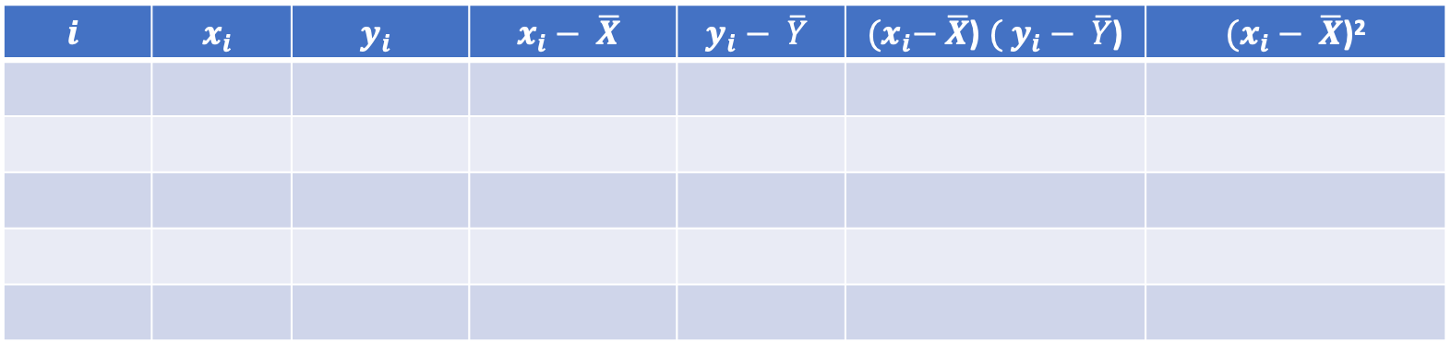
Compute the value of m and b
X | 8 | 2 | 11 | 6 | 5 | 4 | 12 | 9
Y | 3 | 10 | 3 | 6 | 8 | 12 | 1 | 4
$$i$$ | $$x_{i}$$ | $$y_{i}$$ | $$x_{i}− \overline{X}$$ | $$y_{i}− \overline{Y}$$ | ${(x}_{i}− \overline{X}$) $( y_{i}− \overline{Y}$) | $(x_{i}− \overline{X}$)²

Slide 14
Check Normality
Perform the Regression:
Calculate Residuals:
Residual = Y - (a + bX)
Create a Histogram for Residuals:
Visual Inspection:
If the histogram of residuals appears approximately normal (bell-shaped), it suggests that the assumption of normally distributed errors is met for the linear regression model.
If the histogram has substantial skewness or kurtosis or shows a clear departure from normality, it may indicate that the assumptions of the linear regression model are violated.

Slide 15
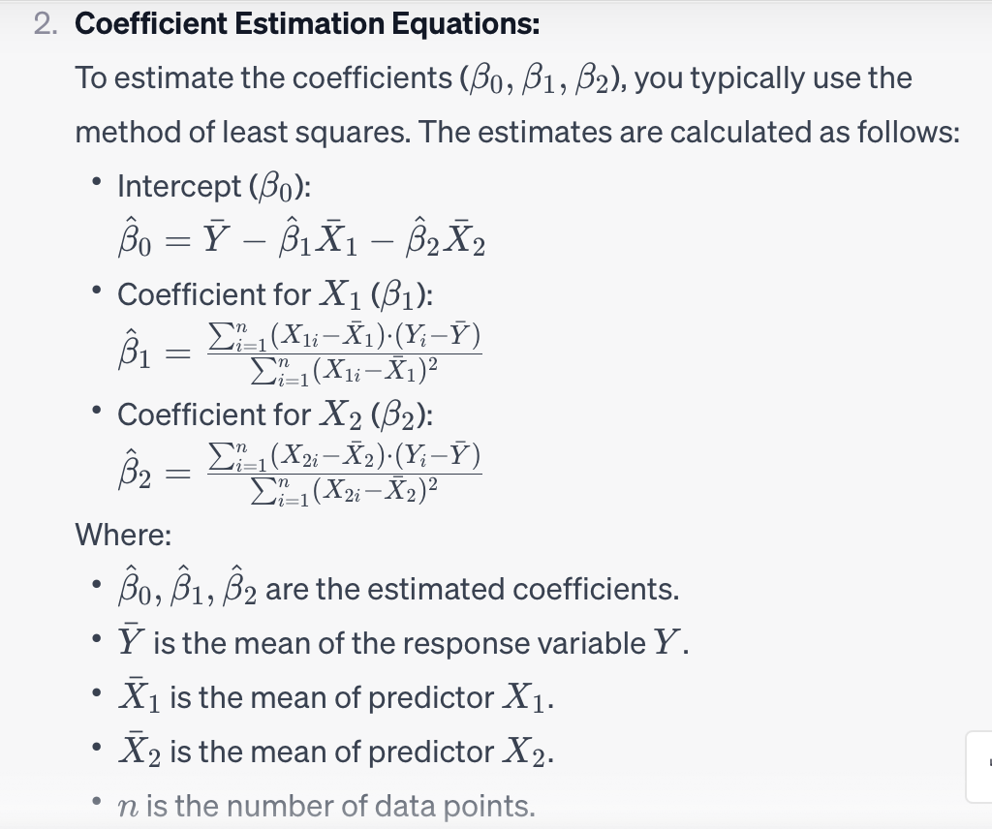
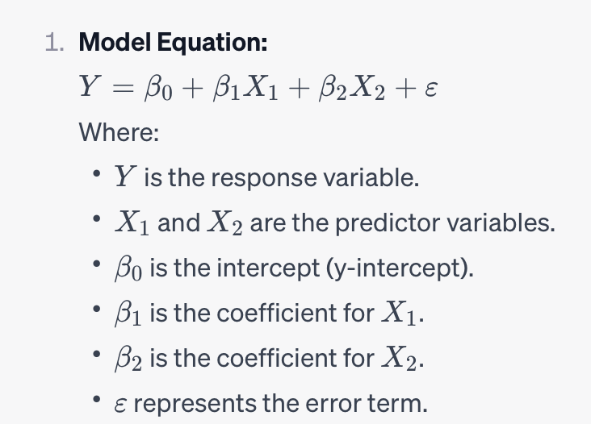
Multiple linear regression with two predictor variables (X1​ and X2​), the linear regression model can be computed using following equation

Slide 16
import numpy as np
from sklearn.linear_model import LinearRegression
# Sample data with two predictors
X = np.array([[1, 2], [2, 4], [3, 5], [4, 6], [5, 8]])
Y = np.array([2, 4, 5, 4, 6])
# Create and fit the multiple linear regression model
model = LinearRegression()
model.fit(X, Y)
# Print the coefficients
print("Intercept (β₀):", model.intercept_)
print("Coefficients (β₁, β₂):", model.coef_)

